Slide 1
Homeostasis
Ability to maintain a steady state despite changing conditions
Water is important to this process because:
a. Makes a good insulator- wet shoe feels warms
b. Resists temperature change
c. Universal solvent- dissolves others
d. Coolant
e. Ice protects against temperature extremes (insulates frozen lakes)
Notes:
4

Slide 2
Solutions & Suspensions
Water is usually part of a mixture.
There are two types of mixtures:
Solutions
Suspensions
Both contain water.

Slide 3
Solution
Ionic compounds disperse as ions in water
Evenly distributed
SOLUTE
Substance that is being dissolved
SOLVENT
Substance into which the solute dissolves

Slide 4
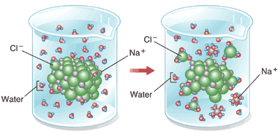
Solution

Slide 5
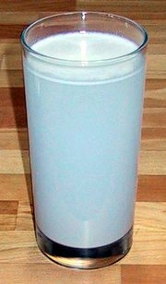
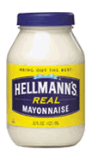
Suspensions
Substances that don’t dissolve but separate into tiny pieces.
Water keeps the pieces suspended so they don’t settle out.

Slide 6
Acids, Bases and pH
One water molecule in 550 million naturally dissociates into a Hydrogen Ion (H+) and a Hydroxide Ion (OH-)
Hydrogen Ion Hydroxide Ion
Acid Base
H₂O  H⁺ + OH⁻

Slide 7
The pH Scale
Indicates the concentration of H⁺ ions
Ranges from 0 – 14
pH of 7 is neutral
pH 0 up to 7 is acid … H⁺
pH above 7 – 14 is basic… OH⁻
Each pH unit represents a factor of 10X change in concentration
pH 3 is 10 x 10 x 10 (1000) stronger than a pH of 6

Slide 8
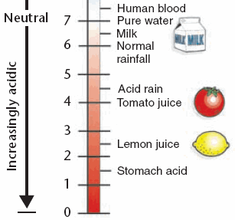
Acids
Strong Acids have a pH of 1-3
Produce lots of H⁺ ions

Slide 9
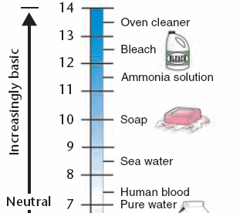
Bases
Strong Bases have a pH of 11 to 14
Contain lots of OH⁻ions and fewer H+ ions

Slide 10
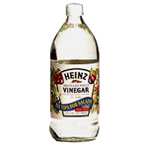
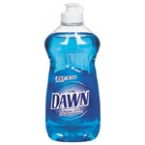
Buffers
Weak acids or bases that react with strong acids or bases to prevent sharp, sudden changes in pH (neutralization).
Produced naturally by the body to maintain homeostasis
Tums = helps to neutralize the acids in the stomach and esophagus.
(man-made buffer)
Weak Acid
Weak Base

