Slide 1

Ecology
... The Study of Nature
How living things interact with each other and their environment.

Slide 2
The world has a very diverse ecology!

Slide 3
Certain populations tend to live in certain climates.
Population- the number of organisms of one species in an area

Slide 4
Certain populations live with each other to form a community.
Community- all the populations living in a certain area.

Slide 5
Communities are very interactive!!!
Abiotic- all the non-living things.
Biotic- all the living things

Slide 6
The sum of all the interactions between all the biotic and abiotic factors in an area is called an:
Ecosystem

Slide 7
Different populations have different roles in a community.
These roles are called Trophic Levels:
Autotrophic- makes their own food
Heterotrophic- rely on others to provide food

Slide 8

Another name for autotrophs is:
Producers- make all the food for the community. Mainly plants are producers.

Slide 9
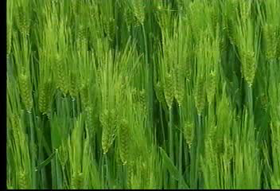
Consumers- organisms that eat other organisms. Mostly animals.
  1st Order or Primary Consumers- eat plants
    Herbivores- eat only plants

Slide 10
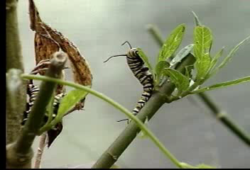
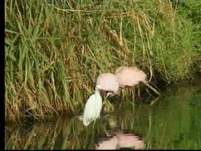
  2nd Order or Secondary Consumers- eat primary consumers
  3rd Order or Tertiary Consumer- eat secondary consumers
  Carnivores- eat only animals
  Omnivores- eat both plants and animals

Slide 11
Terminology Quiz
Eats plants?
Primary Consumer
Eats only animals?
Carnivores

Slide 12
All the turtles in a pond is it’s?
Population
Non-living?
Abiotic
Living?
Biotic

Slide 13
All the living things in the pond?
Community
The plants in
this pond?
Producers

Slide 14
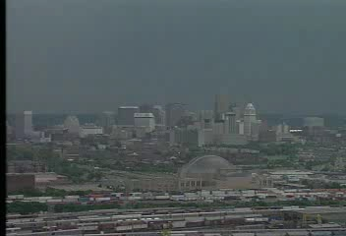
All food energy comes from the Sun!

Slide 15

The sun’s energy gets passed to all organisms on earth through ...
Food Chains- diagrams that show who supplies energy to who in a community

Slide 16
The order of a food chain is always:
Sun
  Producer
    1st Order Consumer
      2nd Order Consumer
        3rd Order Consumer, etc.

Slide 17
And of course, Decomposers always get the last of the energy breaking down all of the dead things!
Sun
  Producer
    1st Order Consumer
      2nd Order Consumer
        3rd Order Consumer, etc.

Slide 18
In reality, any community has many food chains interacting.
Sun Producer Consumers Decomposers
Sun Producer Consumers Decomposers
Sun Producer Consumers Decomposers
Sun Producer Consumers Decomposers
Sun Producer Consumers Decomposers
Sun Producer Consumers Decomposers
Food Web- connecting all of the food chains in a community.

Slide 19
Because energy gets used by organisms in the food chain, there is less energy available at the end. This is called an...
Etc.
2nd
Consumers
1st Consumers
Producers
The Sun
Energy Pyramid

Slide 20
If energy decreases the farther you are along the food chain so will the # of organisms and biomass- total mass of living matter.
Etc.
3rd
Consumers
2nd Consumers
1st Consumers
Producers
#’s and Biomass Pyramid

Slide 21
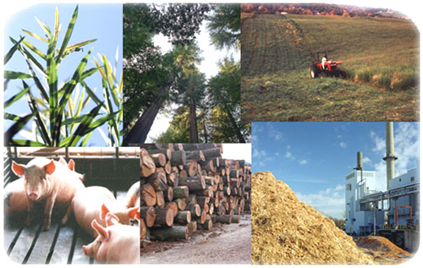
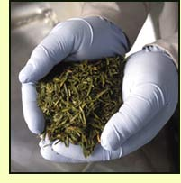
Biomass, Energy and number of organisms are related!

Slide 22
Food Chain
Sun
Grass
Worm
Bird
Fox
Which has more energy, the sun or the Fox?
  Sun, energy is used up in a food chain
Which has more biomass, all the grass in an area or all the foxes?
  Grass, biomass is lost in a food chain

Slide 23
Sun
Grass
Worm
Bird
Fox
Could 100 KG of grass support 100 KG of worms?
  No, only 10 KG
Could 10 KG of worms support 10 KG of birds?
  No, only 1 KG
Could 1000 calories(energy) of bird support 1000 calories of fox?
  No, only about 10 calories

Slide 24
10% Rule- Each trophic level gets only 10% of the total biomass and energy of the level it eats from.

Slide 25
Energy Pyramid- diagram showing how energy(and biomass) is lost as it moves up the trophic levels.

Slide 26
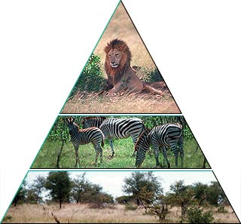
What Trophic Level Should
We Eat At???

Slide 27
All the world’s energy comes from the sun. When the sun is gone...
We’re Gone!

Slide 28
The materials of life, however, are 100% recyclable!

Slide 29
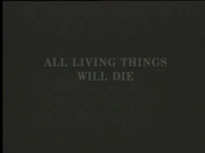
Decomposers- get food energy by breaking down dead things and returning minerals to the soil.
No3
PO3
C

Slide 30
Scavengers are animals that help decomposers by eating dead animals.

Slide 31
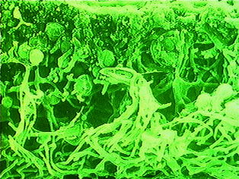
Symbiosis- two or more things living together
Mutualism- both organisms are helped.
E. Coli bacteria
Lichen(Algae+Fungi)

Slide 32
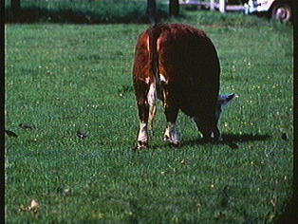
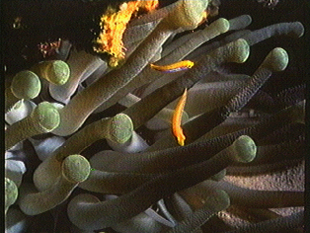
Commensalism- only one organism is helped.

Slide 33
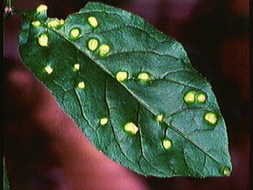
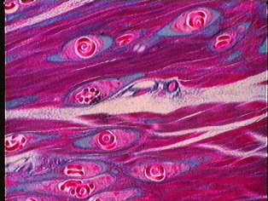
Parasitism- one organism is hurt.
Insect
galls
Trichina Worm
Cysts

Slide 34
Ecology depends on the interaction between biotic and abiotic factors.

