Slide 1
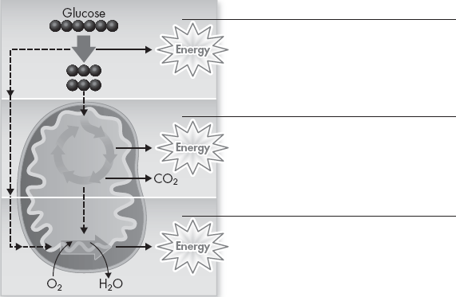
Cell Respiration- Mitochondria

Slide 2
A Comparison of Photosynthesis and Cellular Respiration
Photosynthesis VS.
Cellular Respiration

Slide 3
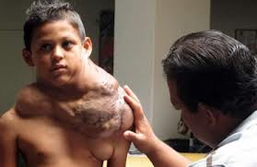
Tumors

Slide 4
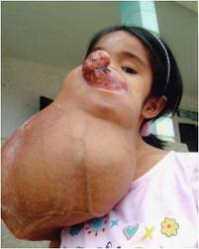
Tumors

