Slide 1
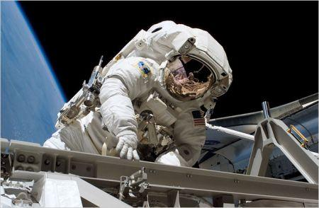
The Methods of Science

Slide 2
What is Science?
1. studies the natural world
2. discovers knowledge 3. discovers nature's "rules and patterns” about how things work
4. only deals with natural phenomena and natural causes
*excludes supernatural

Slide 3
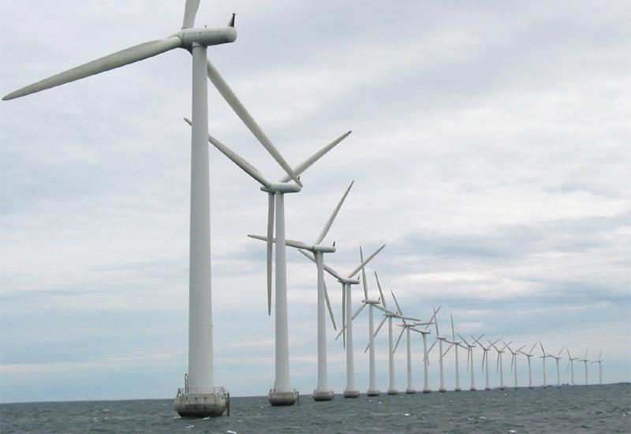
Branches of Science
1. Life science (biology, microbiology, botany, evolution) - deals with living things 2. Earth science (geology, meteorology) - earth, space, rocks, volcanoes, weather 3. Physical science (chemistry, physics) - matter, energy, gravity, light, sound

Slide 4
Scientific Method
A step by step process where a scientist investigates a question by observing and performing experiments.
Step 1 - Question: State the problem or pose a question
Step 2 – Research: Gather information (has someone already investigated this?)
Step 3 - Form a hypothesis
-- a possible explanation or answer

Slide 5
Step 4 - Test the hypothesis: Do experiments, Make measurable observations, Record/ Analyze Data
Experiments have 2 variables
Independent variable - what you change
Responding variable (dependent) - what you measure
If you want to test the affect of fertilizer, you would add fertilizer to a plant (independent variable) and measure how the plant grows (Dependent variable)
A control is something you do nothing to, used to compare your results
control -you will also have a plant that receives no fertilizer

Slide 6
Step 5 - Draw Conclusions
Determine if hypothesis is supported or rejected
If hypothesis is not supported - modify hypothesis
If hypothesis is supported - repeat experiment

Slide 7
Scientific Method in Action
1. What is the best material for insulation? Question. 2. Investigate materials (wool, down, leather) 3. Form a hypothesis
4. Design and conduct experiment. 5. Analyze data
5. Draw conclusions

Slide 8
Modeling
Scientists sometimes use models to help visualize phenomenon. The globe is a model you are familiar with.
Name some other models.....

Slide 9
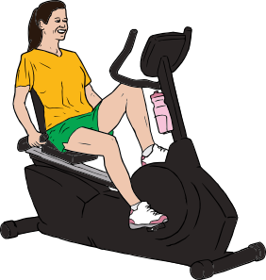
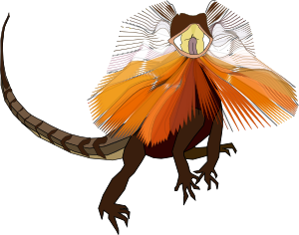
Pick A Question and Design an Experiment
1. Will human urine repel sharks?
2. Does the color red make lizards more aggressive? 3. Will fish grow larger if placed in a larger tank?
4. Does exercise reduce your risk of heart attack?
5. Does aspirin keep cut flowers fresh longer?

Slide 10
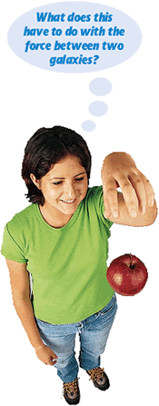
A THEORY is an explanation of why something happens. It comes from many observations and experiments. It can be changed with new data.
Examples: Germ Theory Theory of Evolution
A LAW tells you what happens, like a rule of nature.
Examples: Law of Gravity Law of Thermodynamics

Slide 11
TECHNOLOGY is the application of science to help people
We often thing of technology as things like computers, but technology also includes things like velcro or steel.
What are some other technologies?

Slide 12
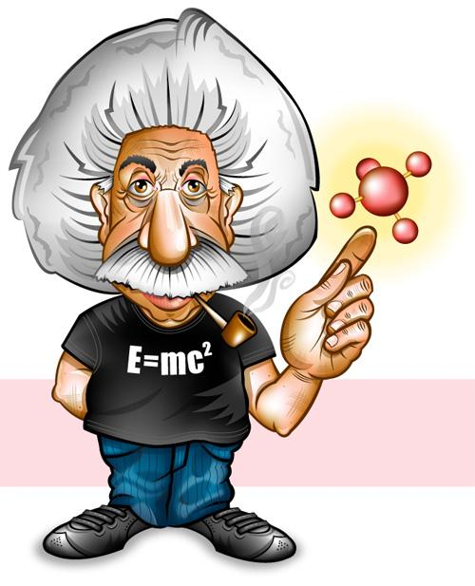
Quiz: The Nature of Science
Use a quiz strip to answer the following questions. You can use your notes to help you answer any of the questions.

Slide 13
1. What branch of science would study volcanoes?
_____________________________
2. Science seeks to find answers about the _________ world.
3. ____________________ is the application of science to help people.
4. In an experiment, the group that receives no treatment and can be used to compare your results is called the __________ group.

Slide 14
5. In an experiment, a goldfish is placed in a 15 gallon tank. Another goldfish is placed in a 50 gallon tank. The experimenter feeds them exactly the same amount of food and weighs them one year later to see which one grew the most.
What is the independent variable in this experiment?
____________________________
6. What is the responding (dependent) variable?
______________________________

Slide 15
7. A step by step process that scientists use to solve problems and answer questions is called the __________ __________
8. A globe is an example of a ________________
9. To analyze data, scientists will often use charts and _____________
10. A scientific ______________ explains why things happen.

