Slide 1
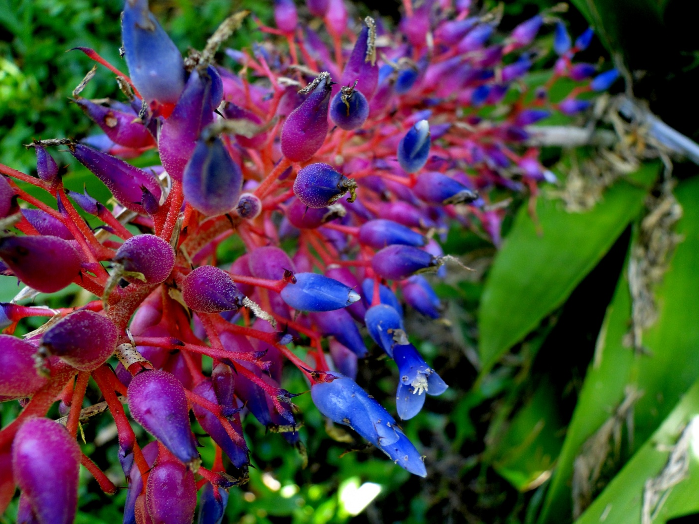
Everything in nature exists for just two reasons…

Slide 2
To ensure an organism’s survival
To ensure an organism’s reproductive success
Adaptations

Slide 3
Your Name
Date
Teacher’s Name
Period
Adaptation
Purpose

Slide 4
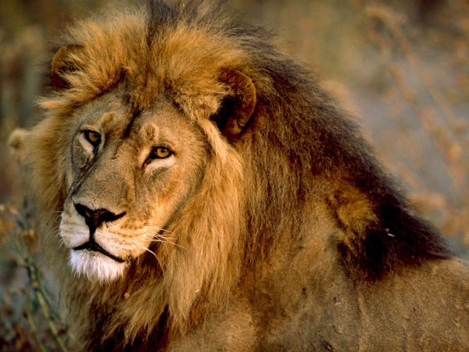
Male Lion (Panthera leo)
Adaptation: thick mane
Purpose: ?

Slide 5
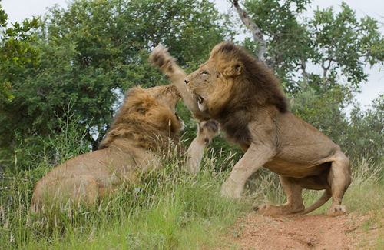
Hint… only male lions have this adaptation
Adaptation: thick mane
Purpose: protects neck during fights

Slide 6
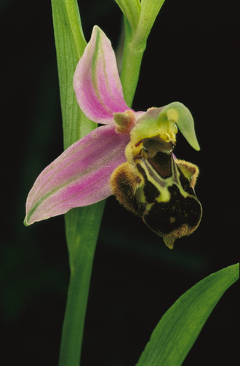
Bee Orchid (Ophyrus apifera)
Adaptation: strange, elaborate flower
Purpose: ?

Slide 7
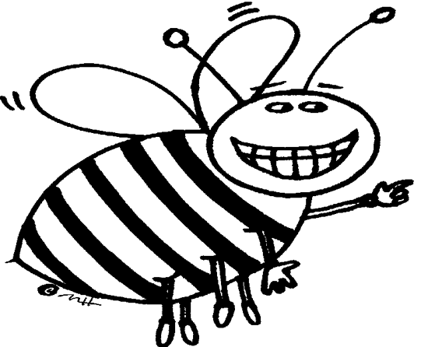
Hint…the orchid is pollinated by just one type of insect…
Adaptation: strange, elaborate flower
Purpose: pollination without nectar

Slide 8
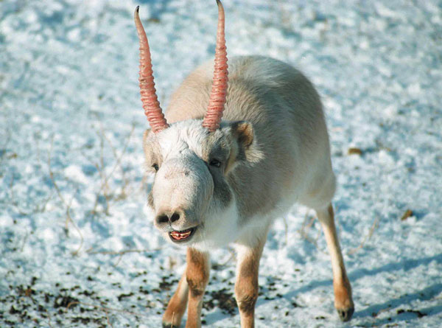
Saiga Antelope (Saiga tatarica)
Adaptation: large, fleshy nose
Purpose: ?

Slide 9
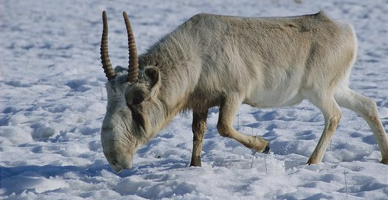
Hint… forages for food in a sub-arctic zone
Adaptation: large, fleshy nose
Purpose: warms the cold air entering the nose and lungs

Slide 10
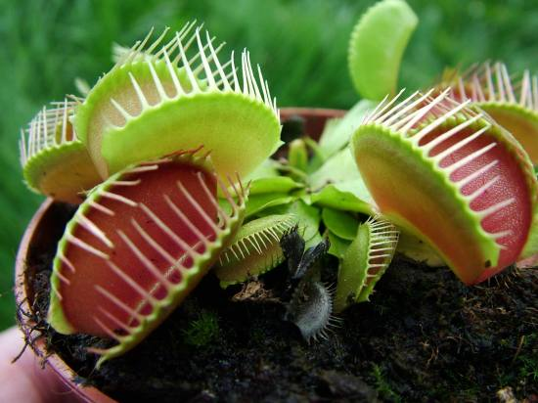
Venus Fly Trap (Dionaea muscipula)
Adaptation: carnivorous
Purpose: ?

Slide 11
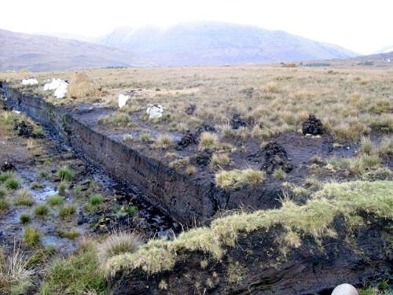
Hint… lives in a nutrient-poor bog environment
Adaptation: carnivorous
Purpose: obtain missing nutrients

Slide 12
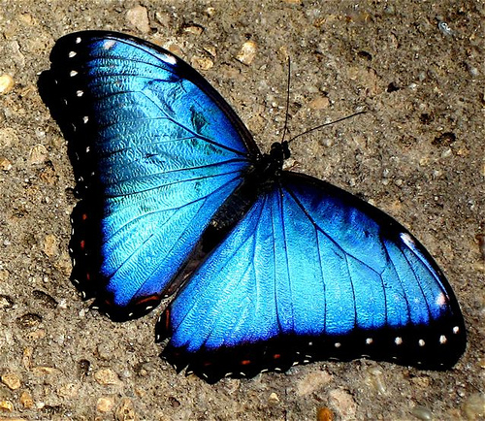
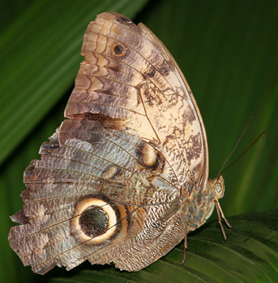
Blue Morpho Butterfly (Genus Morpho)
Adaptation: only visible on ventral side….

Slide 13
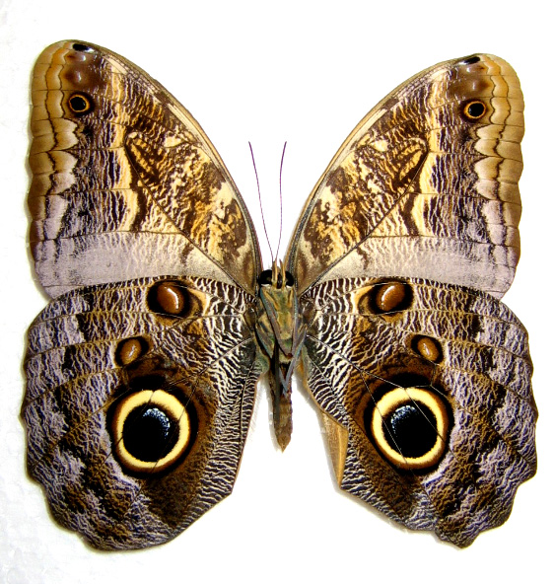
Ventral View

