Slide 1
MEIOSIS
Chapter 11-4

Slide 2
Parents can produce many types of offspring
Families will have resemblances, but no two are exactly alike

Slide 3
Every cell has a nucleus
Every nucleus has chromosomes
The number of chromosomes depends on the species
Ex. Humans have 46

Slide 4
GENES are located on chromosomes
genes control the TRAITS of the individual
genotype determines phenotype

Slide 5
Chromosomes come in matching sets
-these are called homologous pairs

Slide 6
Cells in your body have a complete set (all 46) - they are called DIPLOID
Sex cells (sperm and eggs) only have half (23) - they are called HAPLOID

Slide 8
FIND THE HOMOLOG!

Slide 9
When GAMETES combine, the ZYGOTE (offspring) gets half from mom (23) and half from dad (23)
ZYGOTES are diploid (46)

Slide 10
When sperm and egg meet, their chromosomes must match for the zygote to develop properly.

Slide 11
Let's review terms......
1. Matching sets of chromosomes are called ________ pairs
2. Egg and sperm combine to make a _______________
3. Egg and sperm are both known as _______________
4. A cell that only has half of a set of chromosomes is said to be _______________.
5. Genes are located on ___________________

Slide 12
The process of creating a gamete (sex cell) is called MEIOSIS
It is similar to mitosis, but will produce 4 daughter cells that are each haploid.

Slide 13
Mitosis vs. Meiosis
Produces Somatic (Body) Cells
One division involved
Occurs all over Body & most often
Produces Diploid Cells
Produces 2 IDENTICAL Cells (ensures genetic continuity)
Produces Gametes (Sex Cells)
Two Divisions Involved
Occurs in Testis and Ovaries
Produces Haploid Cells
Produces 4 Genetically DIFFERENT Cells (Variation)

Slide 14
OOGENESIS - makes eggs (ovum)

Slide 15
Spermatogenesis - makes sperm

Slide 16
PROPHASE I of MEIOSIS
- homologous pairs form
-chromosomes trade genes,
CROSSING -OVER

Slide 17
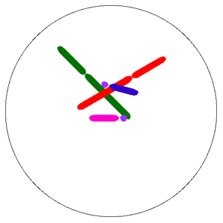
Crossing-over increases the number of possible gene combinations

Slide 18
Crossing Over
Crossing- Over
Bits of SIMILAR information is exchanged between homologous chromosomes.
EX. Brown hair is exchanged with blond.
-This jumbles the genes for more variation.

Slide 19
Steps of Meiosis

Slide 20
Overview of Meiosis

Slide 21
Fertilization
The 2 Haploid Cells (Sperm & Egg) join together and form a Zygote (now diploid).
(mitosis now begins to form the new organism)
The Zygote begins to divide to make 2 cells, 4 cells, 8 cells, 16 cells etc.= new organism

